Slide 1
Intro to Neural Nets
Session 8: Delivering on AI

Slide 2
What is an AI-Mature Company?
Company + Deep Learning != AI Maturity
Has AI delivered new business value? Start with the business first, understanding the relationship between the core demands of the business and the data.
Is AI being deployed in tasks that AI is suited for?
Have you strategically mapped data needs and an acquisition (and expansion) plan?
Dedicated roles for machine learning and data scientists.

Slide 3
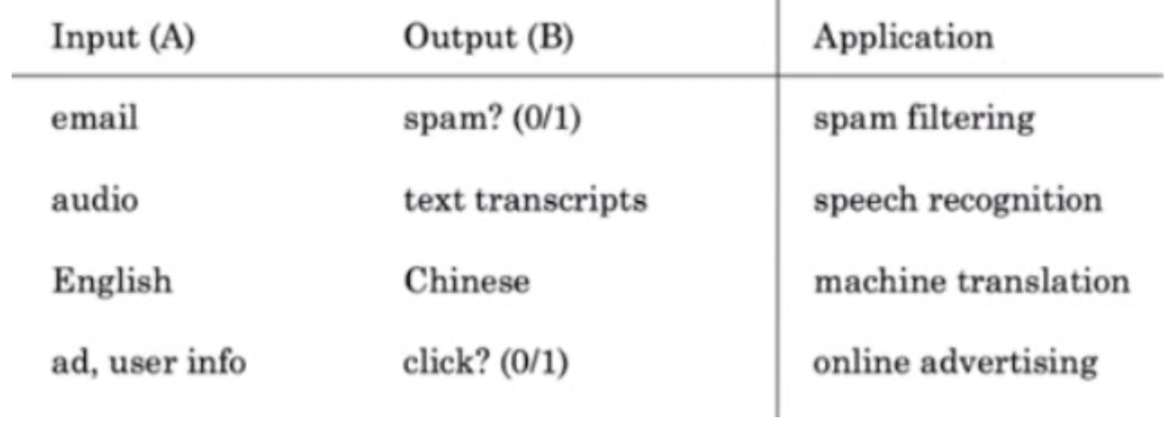
Strengths & Weaknesses of AI
AI for Automation
Any task a human can perform in a few seconds is a candidate for automation via supervised ML, e.g., Deep Learning.

Slide 4
Strengths & Weaknesses of AI

Slide 5
AI as a Complementary Technology

Slide 6
Strengths & Weaknesses of AI

Slide 7
Landing AI

Slide 17
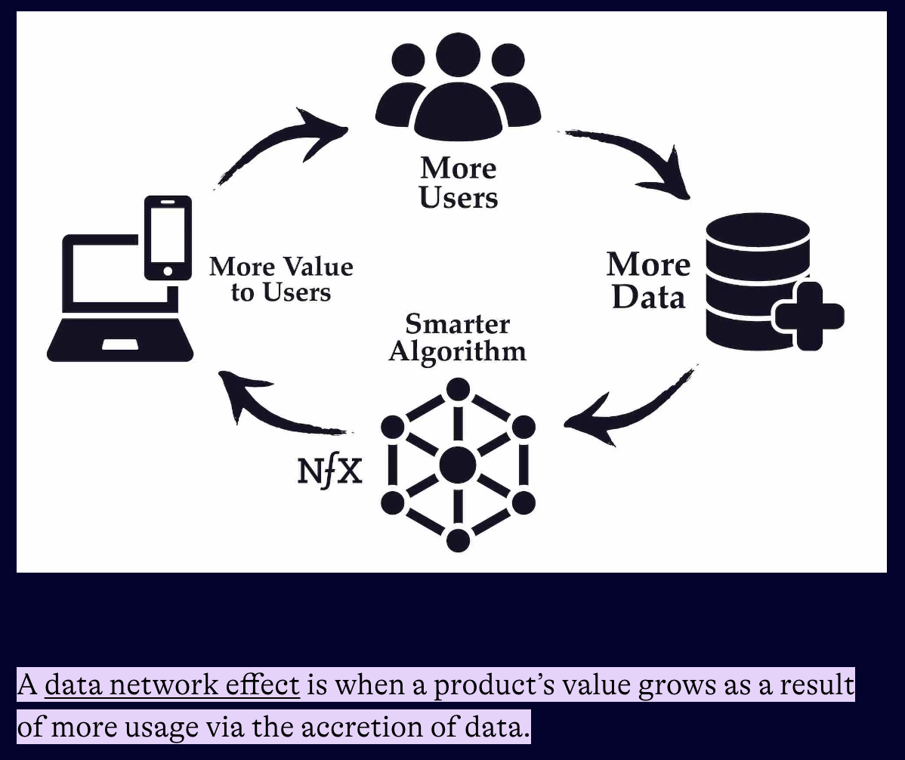
Data Network Effects
Notes:
This is rare and hard to achieve. Waze is a good example…

Slide 18
Getting Started

Slide 19
Thank You! Good Luck on Your AI Journey!

